Slide 1
3. Constituency, Trees, and Rules Noun Phrases (NPs), Adjective Phrases (AdjPs) and Adverb Phrases (AdvPs), Prepositional Phrases (PPs), Verb Phrases (VPs), Clauses, Syntactic representations and drawing trees, Valence Features, Reformulating the Grammar Rules, bracketed Diagrams, Modification and Ambiguity, Constituency Tests.
ENG467: Syntax and Structures of Language

Slide 2
Introduction
Syntax is about the study of sentence structure. So let’s define what we mean by “structure.”
Consider the sentence in (1):
The student loved his syntax assignments.
One way to describe this sentence is as a simple linear string of words. Certainly this is how it is represented on the page or linear order.
We could describe the sentence as consisting of the words the, student, loved, his, syntax, and assignments in that order.
However, syntax is more than just that.
The statement that sentence (1) consists of a linear string of words misses several important generalizations about the internal structure of sentences and how these structures are represented in our minds.

Slide 3
In fact, we are going to say that the words in sentence (1) are grouped into units (called constituents) and that these constituents are grouped into larger constituents, and so on until you get a sentence.
If we observe carefully, with intuition we can say that certain words seem to be closely related to one another.
For example, the word the seems to be tied more to the meaning of student than it is to loved or syntax. A related intuition can be seen by looking at the sentences in (2).
2) a) The student loved his phonology readings.
b) The student hated his morphology professor.
Compare these sentences to (1).
In order to capture these intuitions (the intuition that certain words are more closely connected than others, and the intuitions about relationships between words in the sentence), we need a more complex notion. The notions we use to capture these intuitions are constituency and hierarchical structure.

Slide 4
The idea that the and student are closely related to one another is captured by the fact that we treat them as part of a bigger unit that contains them, but not other words. We have two different ways to represent this bigger unit.
One of them is to put square brackets around units:
3) [the student]
The other is to represent the units with a group of lines in what is called a tree structure:
4)
the student
These bigger units are called constituents.
An informal definition for a constituent is given in (5):
5) Constituent: A group of words that function together as a unit.
Constituency is the most important and basic notion in syntactic theory.

Slide 5
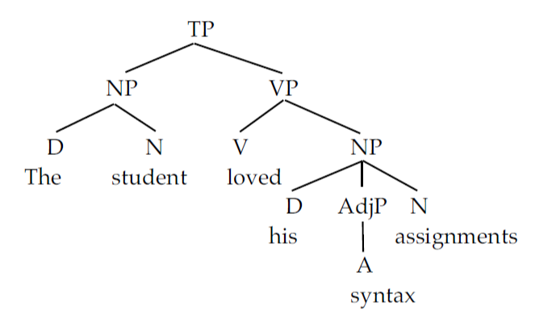
Constituents are embedded one inside another to form larger and larger constituents. This is hierarchical structure.
The structure in example (1) can be represented as in (6):
6)
This is a typical hierarchical tree structure.
The sentence constituent (represented by the symbol TP) consists of two constituents: a subject noun phrase (NP) [the student] and a predicate phrase or verb phrase (VP) [loved his syntax assignments]. The subject NP in turn contains a noun (N) student and a determiner (or article) (D) the. Similarly the VP contains a verb (V), and an object NP [his syntax assignments]. The object NP is further broken down into three bits: a determiner his, an adjective syntax, and a noun assignments.

Slide 6
As you can see this tree has constituents (each represented by the point where lines come together) that are inside other constituents. This is hierarchical structure.
Hierarchical constituent structure can also be represented with brackets.
Each pair of brackets ([ ]) represents a constituent.
We normally put the label of the constituent on the left member of the pair.
The bracketed diagram for (6) is given in (7):
7) [_{TP}[_{NP}[_{D}The][_{N}student]][_{VP}[_{V}loved][_{NP}[_{D}his][_{AdjP}[_{A}djsyntax]][_{N}assignments]]]].
As you can see, bracketed diagrams are much harder to read, so for the most part we will use tree diagrams in this book. However, sometimes bracketed

Slide 7
1. RULES AND TREES
Now we have the tools necessary to develop a simple theory of sentence structure.
We have a notion of constituent, which is a group of words that functions as a unit, and we have labels (parts of speech) that we can use to describe the parts of those units.
Let’s put the two of these together and try to develop a description of a possible English sentence.
In generative grammar, generalizations about structure are represented by rules.
These rules are said to “generate” the tree.
So if we draw a tree a particular way, we need a rule to generate that tree.
The rules we are going to consider in this chapter are called phrase structure rules (PSRs) because they generate the phrase structure tree of a sentence.

Slide 8
1.1 Noun Phrases (NPs)
Let’s start with the constituents we call noun phrases (or NPs) and explore the range of material that can appear in them. The simplest NPs contain only a noun (usually a proper noun [+proper], pronoun [+pron], mass noun [count] or a plural noun [+plural]):
8) a) John b) water c) cats
Our rule must minimally generate NPs that contain only an N.
The format for PSRs is shown in (9a); we use X, Y, and Z here as variables to stand for any category.
(9b) shows our first pass at an NP rule:
9) a) XP X Y Z
the label “consists of” the elements that make up
for the constituent the constituent
b) NP N

Slide 9
This rule says that an NP is composed of (written as ) an N.
This rule would generate a tree like (10):
10) NP
N
There are many NPs (e.g., those that are [+count]) that are more complex than this of course:
11) a) the box
b) his binder
c) that pink fluffy cushion

Slide 10
We must revise our rule to account for the presence of determiners:
12) a) NP D N
This generates a tree like:
b) NP
D N
the box
Compare the NPs in (8) and (11): You’ll see that determiners are optional.
This being so, we must indicate their optionality in the rule. We do this with parentheses ( ) around the optional elements:
13) NP (D) N

Slide 11
Nouns can also be optionally modified by adjectives, so we will need to revise our rule as in (14) (don’t worry about the “P” in AdjP yet, we’ll explain that below).
14) a) the big box b) his yellow binder
15) NP (D) (AdjP) N
Nouns can also take prepositional phrase (PP) modifiers (see below where we discuss the structure of these constituents), so once again we’ll have to revise our rule:
16) a) the big box of crayons
b) his yellow binder with the red stripe
17) NP (D) (AdjP) N (PP)

Slide 12
For concreteness, let’s apply the rule in (17):
18) NP
D AdjP N PP
the box
big of crayons
The NP constituent in (18) consists of four subconstituents: D, AdjP, N and PP.

Slide 13
For the moment, we need to make one more major revision to our NP rule. It turns out that you can have more than one adjective and more than one PP in an English NP:
19) The [_{AdjP} big] [_{AdjP} yellow] box [_{PP} of cookies] [_{PP} with the pink lid].
In this NP, the noun box is modified by big, yellow, of cookies, and with the pink lid. The rule must be changed then to account for this. It must allow more than one adjective and more than one PP modifier. We indicate this with a +, which means “repeat this category as many times as needed”:
20) NP (D) (AdjP+) N (PP+)

Slide 14
1.2 Adjective Phrases (AdjPs) and Adverb Phrases (AdvPs)
Consider the following two NPs:
21) a) the big yellow book
b) the very yellow book
On the surface, these two NPs look very similar. They both consist of a determiner, followed by two modifiers and then a noun. But consider what modifies what in these NPs. In (21a) big modifies book, as does yellow.
In (21b) on the other hand, only yellow modifies book; very does not modify book (*very book) – it modifies yellow. On an intuitive level then, the structures of these two phrases are actually quite different. (21a) has two adjective constituents that modify the N, whereas (21b) has only one [very yellow]. This constituent is called an adjective phrase (AdjP). The rule for the adjective phrase is given in (22a):

Slide 15
22) a) AdjP (AdvP) Adj
b) AdjP
AdvP Adj
yellow
Adv
very

Slide 16
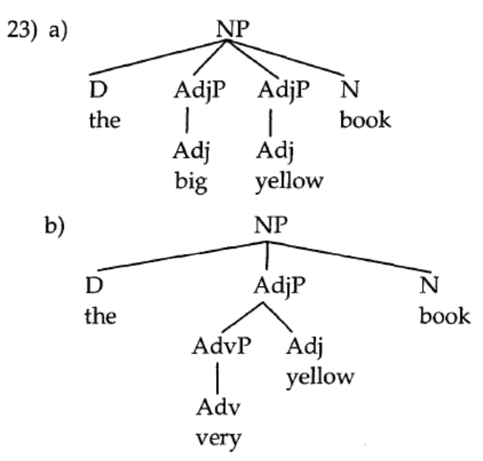
This will give us the following structures for the two NPs in (21):
So despite their surface similarity, these two NPs have radically different structures. In (23a) the N is modified by two AdjPs, in (23b) by only one. This leads us to an important restriction on tree structures:
24) Principle of Modification (informal): Modifiers are always attached within the phrase they
modify.

Slide 17
The adverb very modifies yellow, so it is part of the yellow AdjP in (23b).
In (23a) by contrast, big doesn’t modify yellow, it modifies book, so it is attached directly to the NP containing book.
A very similar rule is used to introduce AdvPs:
25) AdvP (AdvP) Adv
26) very quickly
27) AdvP
AdvP Adv
quickly
Adv
very

Slide 18
Here is a common mistake to avoid: Notice that the AdvP rule specifies that its modifier is another AdvP: AdvP (AdvP) Adv. The rule does NOT say *AdvP (Adv) Adv, so you will never get trees of the form shown in (28):
28) AdvP
Adv Adv
You might find the tree in (27) a little confusing. There are two Advs and two AdvPs. In order to understand that tree a little better, let’s introduce a new concept: heads.
THIS IS WRONG

Slide 19
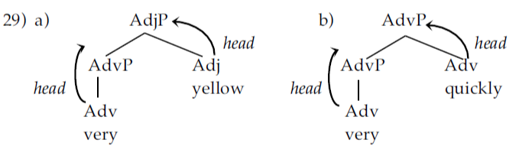
The head of a phrase is the word that gives the phrase its category. For example, the head of the NP is the N, the head of a PP is the P, the head of the AdjP is Adj and the head of an AdvP is Adv.
Let’s look first at an adjective phrase (29a) and compare it to a complex AdvP:
In (29a), the heads should be clear. The adverb very is the head of the adverb phrase and the adjective yellow is the head of AdjP. In (29b) we have the same kind of headedness, except both elements are adverbs. Very is the head of the lower AdvP, and quickly is the head of the higher one. We have two adverbs, so we have two AdvPs – each has its own head.

Slide 20
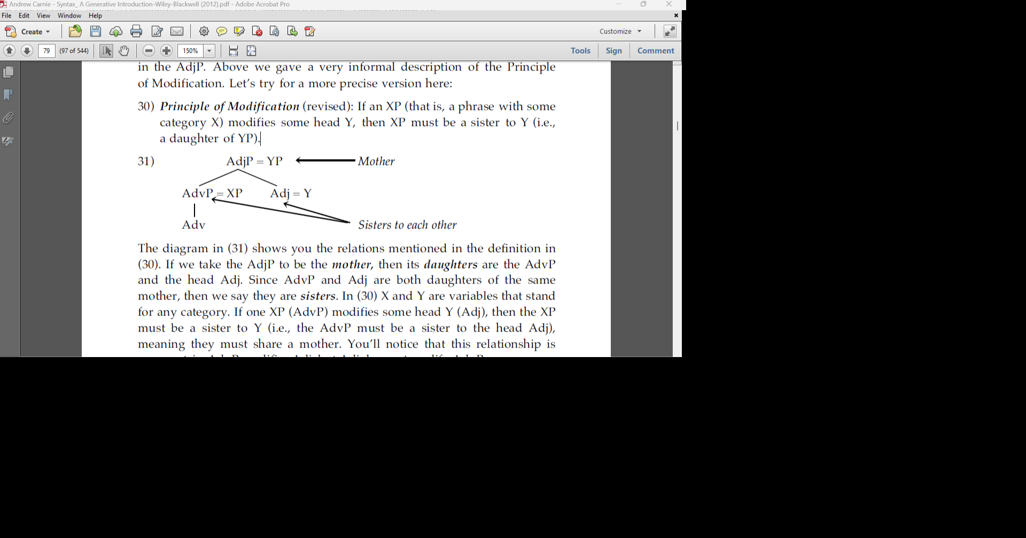
With this in mind, we can explain why the “very” AdvP is embedded in the AdjP. Above we gave a very informal description of the Principle of Modification. Let’s try for a more precise version here:
30) Principle of Modification (revised): If an XP (that is, a phrase with some category X) modifies
some head Y, then XP must be a sister to Y (i.e., a daughter of YP).

Slide 21
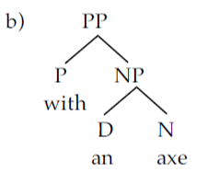
1.3 Prepositional Phrases (PPs)
The next major kind of constituent we consider is the prepositional phrase (PP).
Most PPs take the form of a preposition (the head) followed by an NP:
32) a) [_{PP} to [_{NP} the store]]
b) [_{PP} with [_{NP} an axe]]
c) [_{PP} behind [_{NP} the rubber tree]]
The PP rule appears to be:
33) a) PP P NP

Slide 22
In the rule we’ve given here, the NP in the PP is obligatory. There may actually be some evidence for treating the NP in PPs as optional. There is a class of prepositions, traditionally called particles, that don’t require a following NP:
34) a) I haven’t seen him before.
b) I blew it up.
c) I threw the garbage out.
If these are prepositions, then it appears as if the NP in the PP rule is optional:
35) PP P (NP)

Slide 23
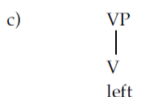
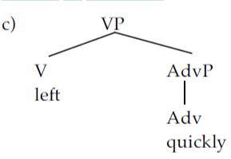
1.4 Verb Phrases (VPs)
Next we have the category headed by the verb: the verb phrase (VP).
Minimally a VP consists of a single verb. This is the case of intransitives (V_{[NP __]):}
36) a) VP V
b) Ignacious [_{VP} left].
Verbs may be modified by adverbs (AdvPs), which are, of course, optional:
37) a) Ignacious [VP left quickly].
b) VP V (AdvP)

Slide 24
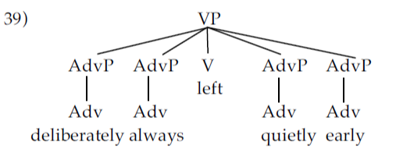
Interestingly, many of these adverbs can appear on either side of the V, and you can have as many AdvPs as you like:
38) a) Ignacious [_{VP} quickly left].
b) Ignacious [_{VP} [_{AdvP} deliberately] [_{AdvP} always] left [_{AdvP} quietly]
[_{AdvP} early]].
c) VP (AdvP+) V (AdvP+)

Slide 25
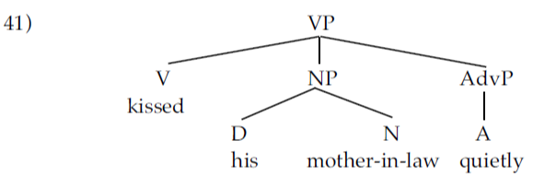
verbs can take an NP object (the transitive V_{[NP __ NP]}); these NPs appear immediately after the V and before any AdvPs:
40) a) VP (AdvP+) V (NP) (AdvP+)
b) Bill [_{VP} frequently kissed his mother-in-law].
c) Bill [_{VP} kissed his mother-in-law quietly]. (cf. *Bill [_{VP} kissed quietly his mother-in-law].)

Slide 26
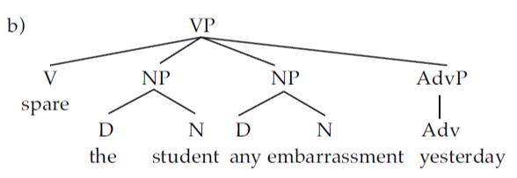
It is also possible to have two NPs in a sentence, for example with a double object verb like spare (V_{[NP __ NP NP]}). Both these NPs must come between the verb and any AdvPs:
42) I spared [_{NP} the student] [_{NP} any embarrassment] [_{AdvP} yesterday].
43) a) VP V (NP) (NP) (AdvP+)

Slide 27

Verbs can be modified by PPs as well. These PPs can be arguments as in ditransitive verbs of the type V[_{NP __ NP PP}] (e.g., the PP argument of the verb put) or they can be simple modifiers like for a dollar below. These PPs can appear either after an adverb or before it.
44) a) Bill [VPfrequently got his buckets [PP from the store ] [PP for a dollar]].
b) VP (AdvP+) V (NP) (NP) (AdvP+) (PP+) (AdvP+)

Slide 28
1.5 Clauses
Thus far, we have NPs, VPs, APs, and PPs, and we’ve seen how they can be hierarchically organized with respect to one another. One thing that we have not accounted for is the structure of the sentence (or more accurately clause).
A clause consists of a subject NP and a VP. The label we use for clause is TP (which stands for tense phrase).
45) [_{TP}[_{NP} Bill ] [_{VP} frequently got his buckets from the store for a dollar]].
This can be represented by the rule in (46):
46) TP NP VP
A tree for (45) is given in (47):

Slide 29


Slide 30

TPs can also include other items, including (unsurprisingly) elements of the category T, such as modal verbs and auxiliary verbs like those in (48):
48) a) Cedric might crash the longboat.
b) Gustaf has crashed the semi-truck.
It may surprise you that we won’t treat these as verbs. The reason for this will become clear in later chapters. Note that the T in the TP is optional.
49) TP NP (T) VP
A tree showing the application of this rule is given in (50):

Slide 31
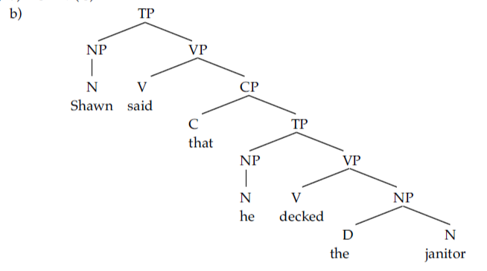
Clauses don’t always have to stand on their own. There are times when one clause is embedded inside another:
In sentence (51) the clause he decked the janitor lies inside the larger main clause. Often embedded clauses are introduced by a complementizer like that or if:
52) [_{TP} Shawn said [_{CP} [_{C} that ] [_{TP} he decked the janitor]]].
We need a special rule to introduce complementizers (C):
53) a) CP (C) TP

Slide 32
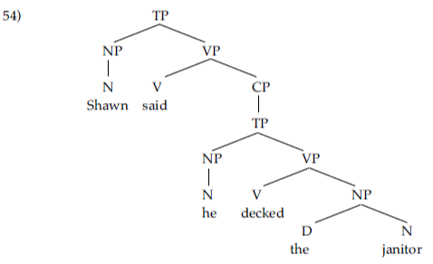
sentence like Shawna said she decked the janitor will have a CP in it even though there is no
complementizer that.

Slide 33
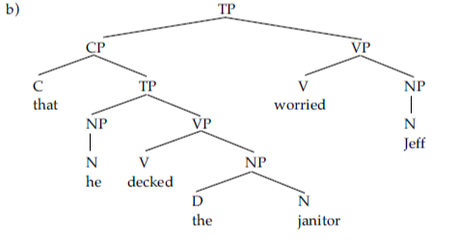
Embedded clauses appear in a variety of positions. In (54), the embedded clause appears in essentially the same slot as the direct object.
Embedded clauses can also appear in subject position:
55) [_{TP} [_{CP} That he decked the janitor] worried Jeff].
56) a) TP {NP/CP} (T) VP

Slide 34
1.6 Coordination (Conjunction)
Coordinators like and, or, but, nor, etc. joined words, phrase, clauses, and sentences.
60) a) the [blue and red] station wagon
b) I saw [these dancers and those musicians] smoking something suspicious.
c) I am [drinking lemonade and eating a brownie].
d) [I’ve lost my wallet or I’ve lost my mind.]
e) We went [through the woods and over the bridge].
The coordination in (a) combines two adjectives into a single modifier, (b) combines two NPs, (c) combines two VPs, (d) two sentences and (e) two PPs.

Slide 35
In order to draw trees with conjunction in them, we need two more rules. These rules are slightly
different than the ones we have looked at up to now. These rules are not category-specific. Instead they use a variable (X). This X can stand for N or V or A or P, etc. Just like in algebra, it is a variable that can stand for different categories. We need two rules, one to conjoin phrases ([The Flintstones] and [the Rubbles]) and one to conjoin words (the [dancer] and [singer]):
61) a) XP XP conj XP
b) X X conj X
These result in trees like the following for the phrases and sentences in (60).

Slide 36
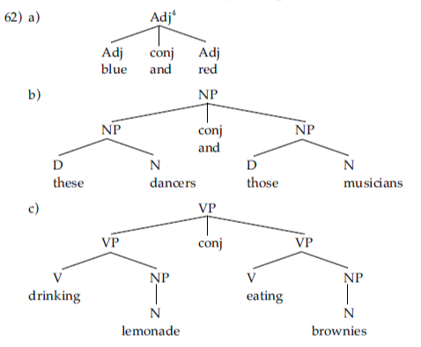

Slide 37
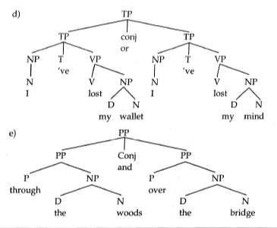

Slide 38
We can summarise the final form of each of the rules here:
S NP VP
CP (C) TP
TP {NP/CP} (T) VP
VP (AdvP+) V (NP) ({NP/CP}) (AdvP+) (PP+) (AdvP+)
NP (D) (AdjP+) N (PP+) (CP)
PP P(NP)
AdjP (AdvP) Adj
AdvP (AdvP) Adv
XP XP conj XP
X X conj X

Slide 39
In short, depending on the sentence, we can have
S NP VP
NP Det N
VP Aux Main
Aux Tense _past_progressive
PP P NP
AdjP (AdvP) Adj
AdvP (AdvP) Adv
XP XP conj XP
X X conj X

Slide 40
2. HOW TO DRAW A TREE
2.1 Bottom-up Trees
1. Write out the sentence and identify the parts of speech:
D Adv Adj N V D N
The very small boy kissed the platypus.
2. Identify what modifies what. Remember the modification relations. If the word modifies something then it is contained in the same constituent as that thing.
Very modifies small. Very small modifies boy.
The modifies boy. The modifies platypus.
The platypus modifies kissed.

Slide 41
3. Start linking together items that modify one another. It often helps to start at the right edge. Always start with adjacent words. If the modifier is modifying a noun, then the rule you must apply is the NP rule:
NP
D Adv Adj N V D N
The very small boy kissed the platypus.
Similarly if the word that is being modified is an adjective, then you must apply the AdjP rule:
AdjP
AdvP NP
D Adv Adj N V D N
The very small boy kissed the platypus.

Slide 42
4. Make sure you apply the rule exactly as it is written. For example the AdjP rule reads AdjP (AdvP) Adj. This means that the Adv must have an AdvP on top of it before it can combine with the Adj.
5. Keep applying the rules until you have attached all the modifiers to the modified constituents. Apply one rule at a time. Work from right to left (from the end of the sentence to the beginning). Try doing the rules
in the following order:
a) AdjPs & AdvPs b) NPs & PPs
c) VPs d) TP
e) If your sentence has more than one clause in it, start with the most embedded clause.

Slide 43
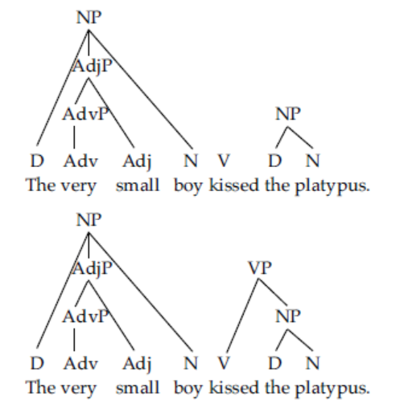

Slide 44
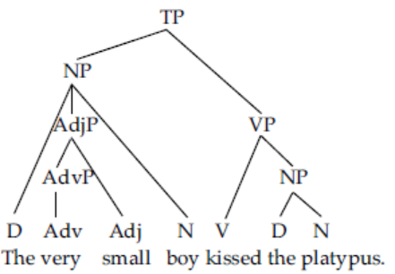
6. When you’ve built up the subject NP and the VP, apply the TP (and if appropriate the CP) rule:

Slide 45
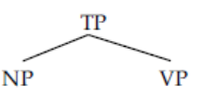
2.2 The Top-down Method of Drawing Trees
1. This method starts out the same way as the other: write out the sentence and identify the parts of speech.
D Adv Adj N V D N
The very small boy kissed the platypus.
2. Next draw the TP node at the top of the tree, with the subject NP and VP underneath:
D Adv Adj N V D N
The very small boy kissed the platypus.

Slide 46
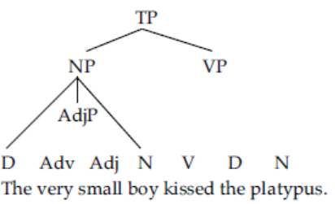
3. Using the NP rule, flesh out the subject NP. You will have to look ahead here. If there is a P, you will probably need a PP. Similarly, if there is an Adj, you’ll need at least one AdjP, maybe more. Remember the Principle of Modification: elements that modify one another are part of the same constituent.

Slide 47
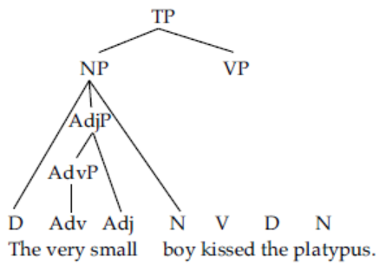
4. Fill in the AdvPs, AdjPs and PPs as necessary. You may need to do other NPs inside PPs.

Slide 48
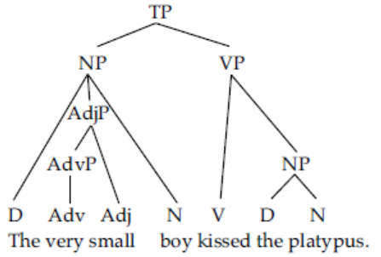
5. Next do constituents inside the VP, including object NPs, and any Aps and PPs inside them.

Slide 49
Draw tress_ exercises
BEFORE Bracketed Diagrams

Slide 50
2.3 Bracketed Diagrams
Sometimes it is preferable to use the bracketed notation instead of the tree notation. This is especially true when there are large parts of the sentence that are irrelevant to the discussion at hand. Drawing bracketed diagrams essentially follows the same principles as tree drawing.
The exception is that instead of drawing to lines connecting at the top, you put square brackets on either side of the constituent. A label is usually put on the left member of the bracket pair as a subscript.
NP
D N
The man = [_{NP}[_{D} the] [_{N} man]]
Both words and phrases are bracketed this way.

Slide 51
First we mark the parts of speech, this time with labeled brackets:
(The sentence is: The very small boy kissed the platypus.)
[_{D} The] [_{Adv} very] [_{Adj} small] [_{N} boy] [_{V} kissed] [_{D} the] [_{N} platypus].
2. Next we apply the AP, NP, and PP rules:
[_{D} The] [_{AdvP} [_{Adv} very]] [_{Adj} small] [_{N} boy] [_{V} kissed] [_{D} the] [_{N} platypus].
[_{D} The] [_{AdjP} [_{AdvP} [_{Adv} very]] [_{Adj} small]] [_{N} boy] [_{V} kissed] [_{D} the] [_{N} platypus].
[_{NP}[D The] [_{AdjP} [_{AdvP} [_{Adv} very]] [_{Adj} small]] [_{N} boy]] [_{V} kissed] [_{D} the] [_{N} platypus].
[_{NP}[D The] [_{AdjP} [_{AdvP} [_{Adv} very]] [_{Adj} small]][_{N} boy]] [_{V} kissed] [_{NP}[_{D}the] [_{N}platypus]].

Slide 52
3. Now the VP and TP rules:
[_{NP}[_{D}The] [_{AdjP}[_{AdvP}[_{Adv}very]] [_{Adj}small] ][_{N}boy]] [_{VP} [_{V}kissed] [_{NP}[_{D}the] [_{N}platypus]]].
[_{TP} [_{NP}[_{D}The] [_{AdjP}[_{AdvP}[_{Adv}very]] [_{Adj}small]] [_{N}boy]] [_{VP}[_{V}kissed] [_{NP}[_{D}the] [_{N}platypus]]]].

Slide 53
Draw tress_ exercises

Slide 54
3. MODIFICATION AND AMBIGUITY
When we use modifiers in a sentence, there is ambiguity in using modifiers.
We will first look at what is modification and ambiguity.
Then, we shall see ambiguity in the use of modifiers in a sentence.

Slide 55
Definitions of modification
Berry (Berry: 2018) defines a modifier as a “subordinate element in an endocentric structure. It is a word group that affects the meaning of a headword in that it describes, limits, intensifies, and/or adds to the meaning of the head.”, e.g.,
The blue shirt
"Blue' describes the word 'shirt', it limits by excluding other colors; and it adds to the plain meaning of shirt.
Doghouse
"house" is the head and "dog" is the modifier, which tells us that the house is intended for a dog.
Dirty dog
'Dirty' is an adjective that modifies the noun dog.

Slide 56
Another definition of modifier is an optional element in the phrase structure of clause structure. Typically the modifier can be omitted without affecting the grammar of the sentence. e.g.
Eg
This is a red ball.
The adjective 'red' is a modifier, modifying the noun 'ball’.
Dypedahl & Hasselgård (2018) define the modifier as an element that depends on the head and modifies the way you are to understand what the head refers to.
E.g.,
His large house.
'His large' modifies the head 'house'.
A lot of expensive furniture.
A lot of expensive' modifies the word 'furniture'.

Slide 57
Crystal (2011) "is a term used in syntax to refer to the structural dependence of one grammatical unit upon another- but with different restriction in the scope of the term being introduced by different approaches."
E.g.,
Big man.
The word 'big' modifies 'man'.

Slide 58
Structure of Modification
It consists of two components: MODIFIER + HEAD
What is HEAD?
The element that the phrase is centred on.
It is the one essential, obligatory element in that phrase.
What is MODIFIER?
It is the element that modifies the head
It is an optional element
Eg.
Handsome _{(M)} + boy _{(H)}
Very handsome _{(M)} + boy _{(H)}
Very _{(M)} + Handsome _{(H)}

Slide 59
The head can be:
• Noun
• Verb
• Adjective
• Adverb
• Preposition
• Unlike the head, the modifiers are limited

Slide 60
H + M = Phrase
• Noun Phrase: naughty boy, rich girl, clever man
• Verb Phrase: go quickly, is beautiful, are paddling away, suddenly turn right
• Adjective Phrase: very rich, rather pretty, not clever, quite okay
• Adverb Phrase: very slowly, so quickly,
• Prepositional Phrase: to the market, from the school, through the door,

Slide 61
Ambiguity
It means the meaning is unclear or the meaning is not explicitly defined.
a situation in which something has more than one possible meaning or there is a possibility of interpreting an expression in two or more distinct ways.
A word, phrase, or sentence is ambiguous if it has more than one meaning, in other words ambiguity has more than one interpretation.

Slide 62
Kinds of Ambiguity
We will talk about two kinds of ambiguity.
Lexical ambiguity : If a word has more that one interpretation and this same piece of information may be ambiguous in one context and unambiguous in another.
eg. Light = not heavy or = not dark
2. Structural ambiguity: It occurs when a phrase or sentence has more than one basic structure and so it has more than one way to understand, even if the individual words of the expression are not lexically ambiguous.
Eg. We shall be discussing violence on TV.
It might mean the discussion will be conducted during a television programme,
or it might mean violence on TV is the topic to be discussed.

Slide 63
Some more examples of structural ambiguity or sentence ambiguity:
1. The man saw the woman with a telescope.
2. The old men and women left the room.
3. The chicken is ready to eat.
4. Flying planes can be dangerous.
5. The princess killed the king with the knife

Slide 64
Modification and Ambiguity in syntactic structure
Sentences often are ambiguous.
Since we are dealing with syntactic trees, we shall see how syntactic trees allow us to capture another important fact about syntactic structure: that is the ambiguous sentences.
Let’s take the following sentence:
1. The princess killed the king with the knife.
This sentence turns out to have more than one meaning.

Slide 65
Now, to draw a tree structure, we need to the remember the principle of modification which says:
Principle of Modification : If an XP (that is, a phrase with some category X) modifies some head Y, then XP must be a sister to Y (i.e., a daughter of YP).

Slide 66
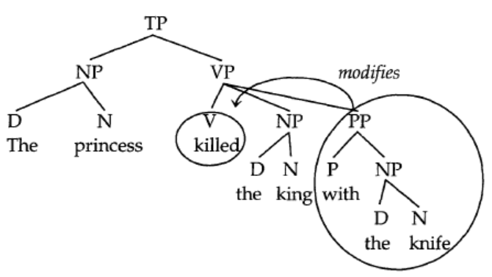
First interpretation
In this first meaning, the PP with the knife modifies killed, so the structure will look like (1a):
(1a)
[With the knife] describes how the man killed the king. It modifies the verb killed, so it is attached under the VP.
The paraphrase is this - the man used the knife to kill the king.

Slide 67
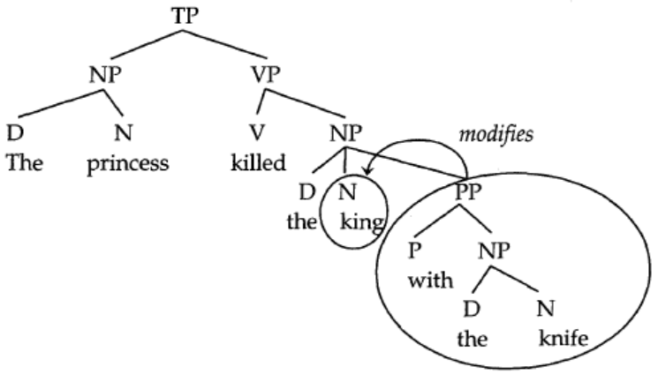
Second interpretation
Now consider a paraphrase of the other meaning of the sentence. "the king with the knife was killed by the man (who used a gun)." This meaning has the PP with the knife modifying king, and thus attached to the NP:
(1b)

Slide 68
These examples illustrate an important property of syntactic trees.
Trees allow us to capture the differences between ambiguous readings of the same surface sentence.
So, for each sentence, draw two separate tree diagram that illustrate the different meanings;
we make sure by paraphrasing the sentence, and showing the interpretation of each tree.

Slide 69
4. Constituency Tests
We speak of linguistics in general (and syntax specifically) as the scientific method. So, if we make a hypothesis about something, we must be able to test that hypothesis. We have also proposed the hypothesis that sentences are composed of higher-level groupings called constituents.

Slide 70
Constituents are a group of words that function together as a unit in a sentence.
Constituents are represented in tree structures and are generated by rules.
If this is the case, then we should find instances where groups of words behave as single units.
These instances can serve as tests for the hypothesis.
In other words, they are tests for constituency. There are a lot of constituency tests listed in the syntactic literature. We are going to look at only four here: replacement, stand-alone, movement, and coordination.

Slide 71
Constituent Test
1. Replacement test
The smallest constituent is a single word, so it follows that if you can replace a group of words with a single word then we know that group forms a constituent.
Consider the italicized NP in (1). It can be replaced with a single word (in this case a pronoun). This is the replacement test.
1) a) The old man ate his delicious broccoli.
b) He ate his delicious broccoli.
c) He ate it.

Slide 72
2. Stand-alone test or Sentence fragment test
The second test is the stand-alone test (sometimes also called the sentence fragment test).
If the words can stand alone in response to a question, then they probably constitute a constituent. Consider the sentence in (2a) and repeated in (2b).
We are going to test for the constituency of the italicized phrases.
2) a) Paul ate at a really fancy restaurant.
b) Paul ate at a really fancy restaurant.
If we ask the question “What did Paul do yesterday afternoon?” we can answer with the italicized group of words in (3a), but not in (3b):
3) a) Ate at a really fancy restaurant.
b) *Ate at.
Neither of these responses is proper English in prescriptive terms, but you can easily tell that (74a) is better than (74b).

Slide 73
3 Movement
Movement is our third test of constituency. If you can move a group of words around in the sentence, then they form a constituent – because you can move them as a unit.
Some typical examples are:
Clefting - involves putting a string of words between It was (or It is) and a that at the beginning of the sentence.
Preposing (also called pseudoclefting) - involves putting the string of words before a is/are what or is/are who at the front of the sentence.
Passive - it involves putting the object in the subject position, the subject in a “by phrase” (after the word by) and changing the verb form (for example from kiss to was kissed).

Slide 74
We will see the example sentences below:
4) a) Clefting: It was [a brand new car] that she bought.
(from She bought a brand new car)
b) Preposing: [Big bowls of beans] are what I like.
(from I like big bowls of beans)
c) Passive: [The big boy] was kissed by [the slobbering dog].
(from The slobbering dog kissed the big boy)
Again, the movement test is only reliable when you keep the meaning roughly the same as in the original sentence.

Slide 75
4. Coordination
Finally, we have the test of coordination (also called conjunction).
Coordinate structures are constituents linked by a conjunction like and or or.
Only constituents of the same syntactic category can be conjoined:
5) a) [Anita] and [the man] went to the store.
b) *Anita and very blue went to the store.
If you can coordinate a group of words with a similar group of words, then they form a constituent.

Slide 76
Summary of what we have covered so far:
i) Constituent: A group of words that function together as a unit.
ii) Hierarchical Structure: Constituents in a sentence are embedded inside of other constituents.
iii) Syntactic Trees and Bracketed Diagrams: These are means of representing constituency. They are
generated by rules.

Slide 77
iv) English Phrase Structure Rules
a) CP (C) TP
b) TP {NP /CP} (T) VP
c) VP (AdvP+) V (NP) ({NP /CP}) (AdvP+) (PP+) (AdvP+)
d) NP (D) (AdjP+) N (PP+) (CP)
e) PP p (NP)
f) AdjP (AdvP) Adj
g) AdvP (AdvP) Adv
h) XP XP conj XP
i) X Xconj X

Slide 78
v) Head: The word that gives its category to the phrase.
vi) Recursion: The possibility of loops in the phrase structure rules that allow infinitely long sentences, and
explain the creativity of language.
vii) The Principle of Modification: If an XP (that is, a phrase with some category X)
modifies some head Y, then XP must be a sister to Y (i.e., a daughter of YP).
viii) Constituency Tests: Tests that show that a group of words functions as a unit.
There are four major constituency tests given here: movement, coordination, stand-alone, and
replacement.

Slide 79
References
1. Carnie, A. (2021). Syntax: A Generative Introduction (Fourth Edition). Wiley Blackwell.
2. (PDF) English Syntax - Sentence Structure: Structure of Modification. Available from: https://www.researchgate.net/publication/368336374_English_Syntax_-_Sentence_Structure_Structure_of_Modification [accessed Aug 27 2024].
3. Saleh, Y. M., Hasan, S. H., & Hameed, A. M. Clarifying Linguistic Ambiguity of Modification.
https://www.redalyc.org/journal/279/27966514018/27966514018.pdf [accessed Aug 28 2024].
4. https://www.researchgate.net/publication/368336374_English_Syntax_-_Sentence_Structure_Structure_of_Modification/references [accessed Aug 28 2024].

